Slide 1
Importance of Data Cleaning and Preprocessing
AI & Data Science
By
Muhammad Sanan Qureshi

Slide 2
Outline
Data and Information
Data Cleaning
Data Preprocessing
Data Transformation
Data Normalization
Data Imputation
Outliers
Data Wrangling
Feature Engineering

Slide 3


Data and Information
A data is something in a raw form that should be processed to extract a useful information out of it.

Slide 4
Data Cleaning
Data can be messy – like spelling mistakes, missing info, or extra spaces.
Data cleaning means fixing these problems.
Importance:
Helps computers understand data better
Gives correct answers in models and graphs
Saves time in the long run

Slide 5
Data Cleaning Steps
Remove extra spaces
Fix spelling mistakes
Handle missing values
Check for duplicates
Correct Outliers
New columns

Slide 6
Let’s get back to Google Collab!
Wee

Slide 7
Technical Terms
Pandas: Use to make data into a tabular form
Strip(): This removes extra spaces before or after the name.
Title(): This capitalises the first letter of each word in the name.
Lambda: is just a shortcut way to write a rule for each item in a column, without creating a big function.

Slide 8
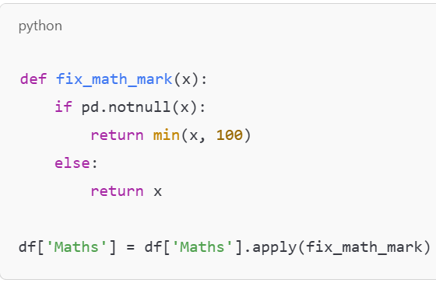
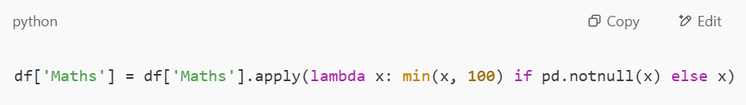

Slide 9
Data Preprocessing - I
Data Preprocessing is the process of getting raw data ready for machines (like AI models) to use.
It means cleaning, organising, and changing the data so that it's easy to understand and analyse.

Slide 10
Data Preprocessing – II
Importance
Machines can't handle messy or missing data well.
Good data helps AI give better and smarter answers.
It's like getting ingredients ready before cooking!

Slide 11
Data Preprocessing - III
Remove extra spaces and wrong spellings
Fix missing values (e.g. fill in average marks)
Fix wrong values (e.g. marks above 100 or below 0)
Standardise text (e.g. ‘australia’ → ‘Australia’)
Convert data types (e.g. dates or numbers)
Create new columns (e.g. Age from Year of Birth)
Remove duplicate rows

Slide 12
Data Transformation – I
Data Transformation means changing the data into a new format that is better for learning or analysis.
Think of it like repacking your school bag — putting everything in the right place, so it’s easier to carry and find!

Slide 13
Data Transformation – II
Importance
It helps data become easier to use for AI models.
It makes data more accurate, consistent, and useful.
AI models understand numbers better than text — we help with that!

Slide 14
Data Transformation – III
Original Data | Transformed Data
"2010" (year) | Age = 2024 - 2010 = 14
"australia" | "Australia" (correct case)
-5 (marks) | 0 (fixed minimum)
"Yes" / "No" | 1 / 0 (converted to numbers)

Slide 15
Data Transformation – III
Common transformations:
Changing text to numbers
Turning year into age
Making all text the same format
Fixing out-of-range values
Creating new useful columns (e.g. Total Marks)
Suppose you have a column with "Yes" and "No" values. We can transform it into 1 and 0, because machines understand numbers better than words!

Slide 16
Data Normalization – I
Data Normalization is the process of making numbers smaller and similar so they are easier to compare.
It helps AI look at the data fairly — like comparing apples to apples, not apples to watermelons!

Slide 17
Data Normalization – II
Importance
Some numbers (like marks) may be out of 100, others (like age) out of 50.
Bigger numbers can confuse AI models.
Normalising puts all values in the same range, usually between 0 and 1.

Slide 18
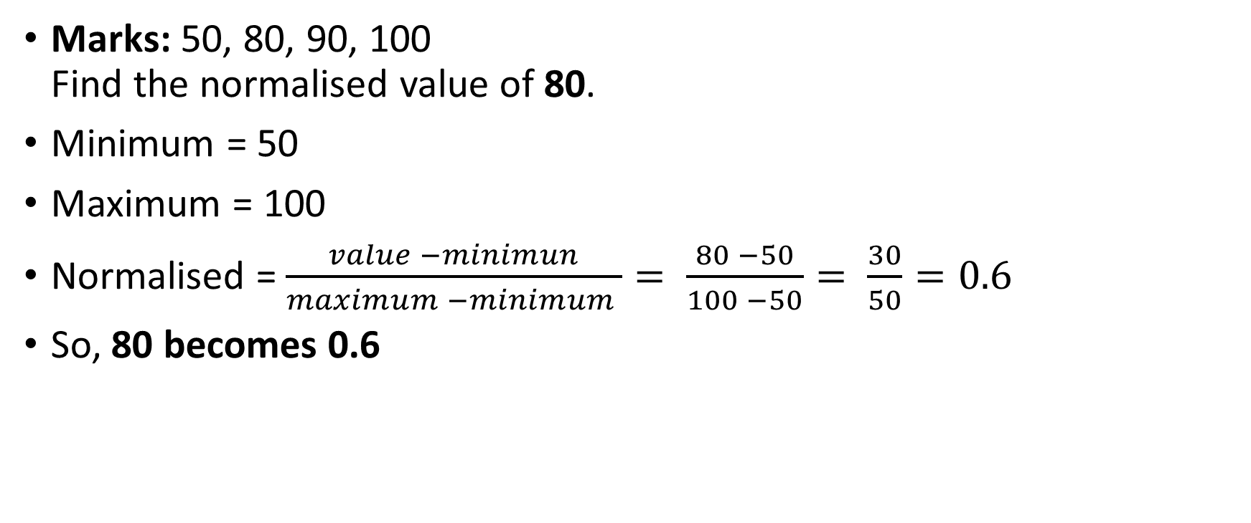
Data Normalization – III
Marks: 50, 80, 90, 100 Find the normalised value of 80.
Minimum = 50
Maximum = 100
Normalised = $\frac{value −minimun}{maximum −minimum }= \frac{80 −50}{100 −50}= \frac{30}{50}=0.6$
So, 80 becomes 0.6

Slide 19

Data Normalization – IV
Heights (in cm): 140, 150, 160, 170 Find the normalised value of 160.
Normalised = $\frac{value −minimun}{maximum −minimum }= \frac{160 −140}{170 −140}= \frac{20}{30}=0.67$

Slide 20
Data Normalization – V
Ages: 10, 12, 14, 15 Find the normalised value of 12.
Normalised value = 0.4
A boy scores 10 in Age and 90 in Maths. Without normalising, the AI might think Maths is more important just because it’s a bigger number!

Slide 21
Data Imputation – I
Data Imputation means filling in missing values in a dataset so it becomes complete and useful.
Think of it like guessing a missing puzzle piece using the pieces around it!

Slide 22
Data Imputation – II
Importance
AI can’t work well if some data is missing.
We use smart guesses to fill in the blanks.
It helps us avoid deleting good data just because one value is missing.

Slide 23
Data Imputation – III
Mean Imputation: Replace with the average of the column.
👉 e.g., If Maths marks are 80, 90, (missing), use:(80+90)÷2=85(80+90)÷2=85
Median Imputation: Replace with the middle value when sorted.
👉 e.g., If marks are 70, 85, (missing), 90, use 85.
Mode Imputation: Replace with the most common value.
👉 e.g., If Year of Birth is: 2010, 2011, 2010, (missing) Use 2010 because it appears most.
Constant Value: Replace missing marks with a fixed number, like 0 or "Unknown".

Slide 24
Data Imputation – IV
https://www.geeksforgeeks.org/mean-median-mode/

Slide 25
Outliers – I
An outlier is a value in the data that is very different from the other values.
It's like someone way taller or way shorter than everyone else in class!

Slide 26
Outliers – II
Outliers can confuse AI models.
They may be mistakes (like typing 999 instead of 99).
Sometimes, they show something interesting or special.

Slide 27
Outliers – III
Student | Marks
Asha | 85
Riya | 87
Meera | 90
Kabir | 92
Ansh | 12 ← ❗ Outlier

Slide 28
Outliers – IV
Check if it's a mistake (e.g., wrong typing)
Decide whether to:
Keep it (if it's real)
Remove it (if it's a mistake)
Replace it with a more reasonable value

Slide 29
Data Wrangling – I
Data Wrangling means collecting, cleaning, and organising messy data to get it ready for use.
It's like tidying up your room so you can find things easily!

Slide 30
Data Wrangling – II
Real-world data is usually messy.
Wrangling makes it neat and organised.
It helps AI and humans make better decisions from data.

Slide 31
Data Wrangling – III
Collecting data (from files, websites, sensors, etc.)
Removing duplicates
Filling in missing values (imputation)
Fixing errors (e.g. spelling mistakes, wrong numbers)
Changing formats (e.g. “5th May 2025” → “2025-05-05”)
Creating new columns (e.g. Age from Year of Birth)
Merging datasets (e.g. joining marks and attendance)

Slide 32
Data Wrangling – IV
Imagine you have student data from two schools:
One school writes names in capital letters, another in small letters.
Some students forgot to write their year of birth.
Some names appear twice.
🧹 Data Wrangling helps:
Fix names (e.g. “ALICE” → “Alice”)
Fill missing birth years
Remove duplicate names

Slide 33
Feature Engineering – I
Feature Engineering means creating new useful data (called features) from the existing data to help machines learn better.
It’s like making new Lego pieces from old ones to build something better!

Slide 34
Feature Engineering – II
AI learns from features (data columns).
Better features = better understanding = smarter AI.
Helps models see patterns more clearly.

Slide 35
Feature Engineering – III
Original Data | New Feature Created
Year of Birth = 2010 | Age = 2025 - 2010 = 15
Marks in 3 subjects | Total Marks = Maths + Science + English
Date = "2025-05-10" | Day = "Saturday", Month = "May"
Height & Weight | BMI = Weight ÷ (Height × Height)

Slide 36
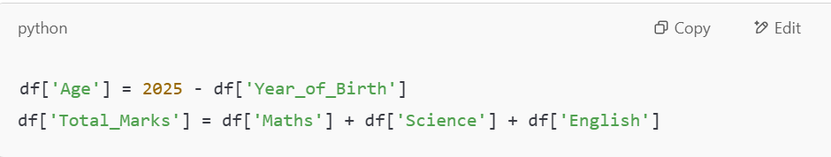
Feature Engineering – IV
You have :
Now AI can use Age and Total Marks — features you created yourself!

Slide 37
The End.
Thanks!

